Slide 1
Case Study Airbnb NYC
From : Anurag Aditya & Pragyan Seth

Slide 2
Objective :
Airbnb, Inc. is an American company that operates an online marketplace for lodging, primarily homestays for vacation rentals, and tourism activities.
Based in San Francisco, California, the platform is accessible via website and mobile app. Airbnb does not own any of the listed properties; instead, it profits by receiving commission from each booking.
During the covid time, Airbnb incurred a huge loss in revenue.
People have now started travelling again and Airbnb is aiming to bring up the business again and are ready to provide services to customers.

Slide 3
Background :
Now that the restrictions have started lifting and people have started to travel more, Airbnb wants to make sure that it is fully prepared for this change.
The different leaders at Airbnb want to understand some important insights based on various attributes :
Data Analysis Managers: These people manage the data analysts directly for processes and their technical expertise is basic.
Lead Data Analyst: The lead data analyst looks after the entire team of data and business analysts and is technically sound.
Head of Acquisitions and Operations, NYC: This head looks after all the property and host acquisitions and operations. Acquisition of the best properties, price negotiation, and negotiating the services the properties offer falls under the purview of this role.
Head of User Experience, NYC: The head of user experience looks after the customer preferences and also handles the properties listed on the website and the Airbnb app. Basically, the head of user experience tries to optimize the order of property listing in certain Neighbourhood and cities in order to get every property the optimal amount of traction.

Slide 4
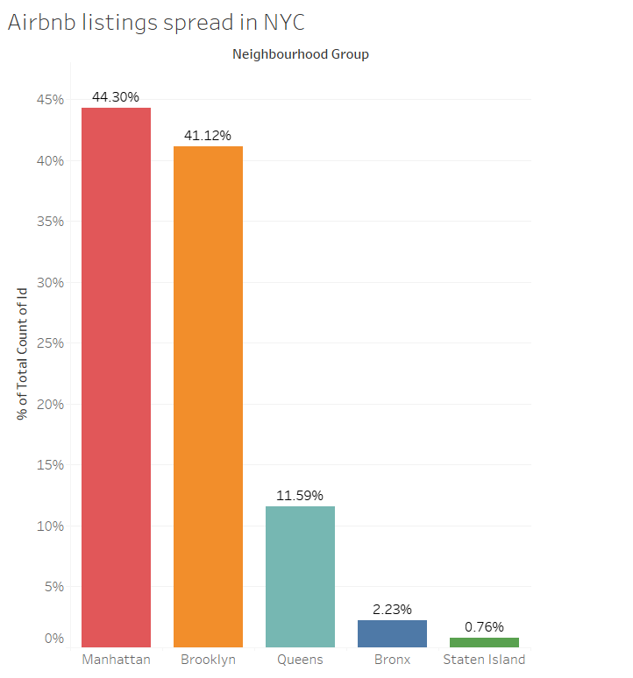
Airbnb listings spread in NYC:
According to the dataset provided for Airbnb NYC :
In Manhattan Airbnb is spread of 44.30 %
Brooklyn spread with 41.12% Queens spread with 11.59%
Bronx spread with 2.23% and Staten Island 0.76%

Slide 5
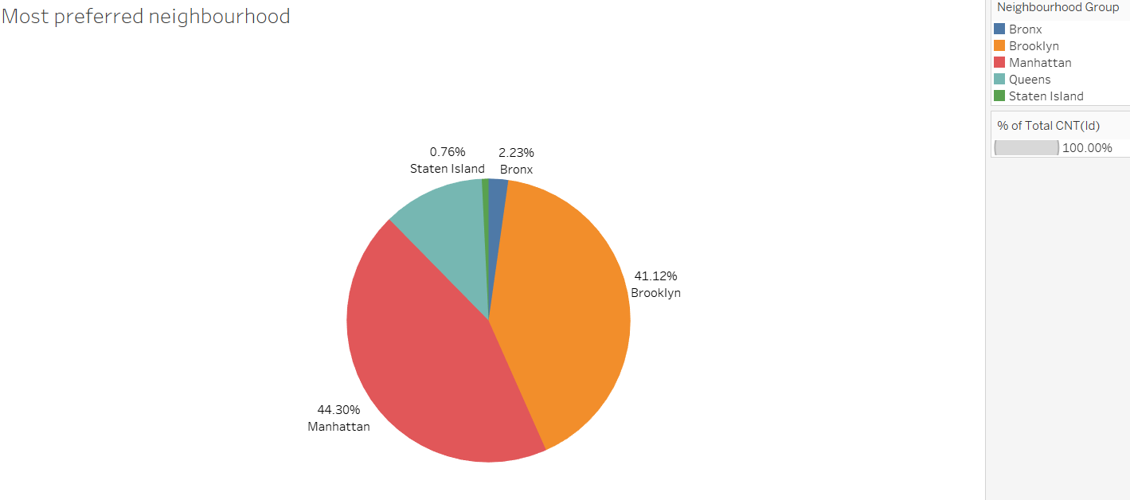
Most preferred Neighbourhood groups:
According to the data set provided:
Customers most preferred area is Manhattan and the least preferred area is Staten Island because the booking done for these areas are 44.30% (Manhattan) as highest compared to Staten Island as lowest with percentage of 0.76%

Slide 6
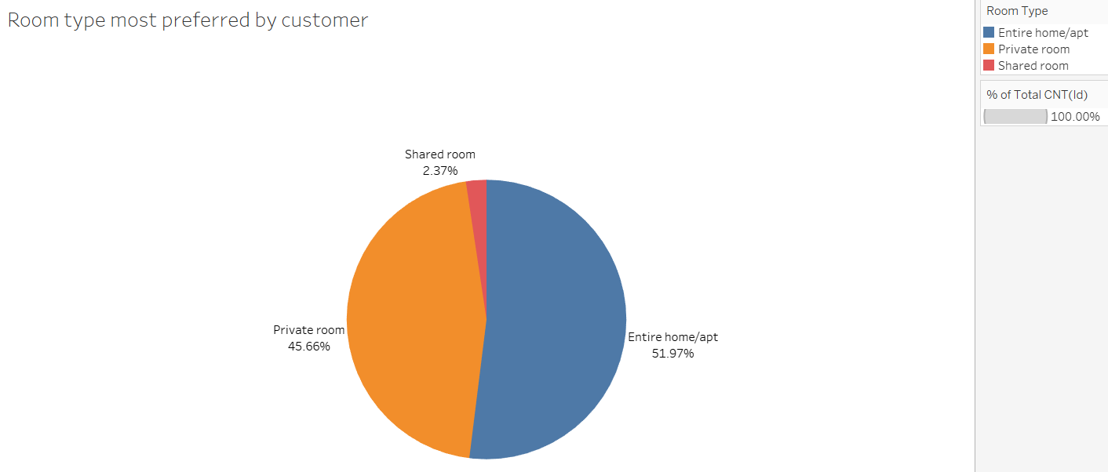
Room type most preferred by customer :
According to the dataset provided most preferred room type by customers is :
Entire home/apt with percentage of 51.97%
Private room with percentage of 45.66%
Shared room with percentage of 2.37%

Slide 7
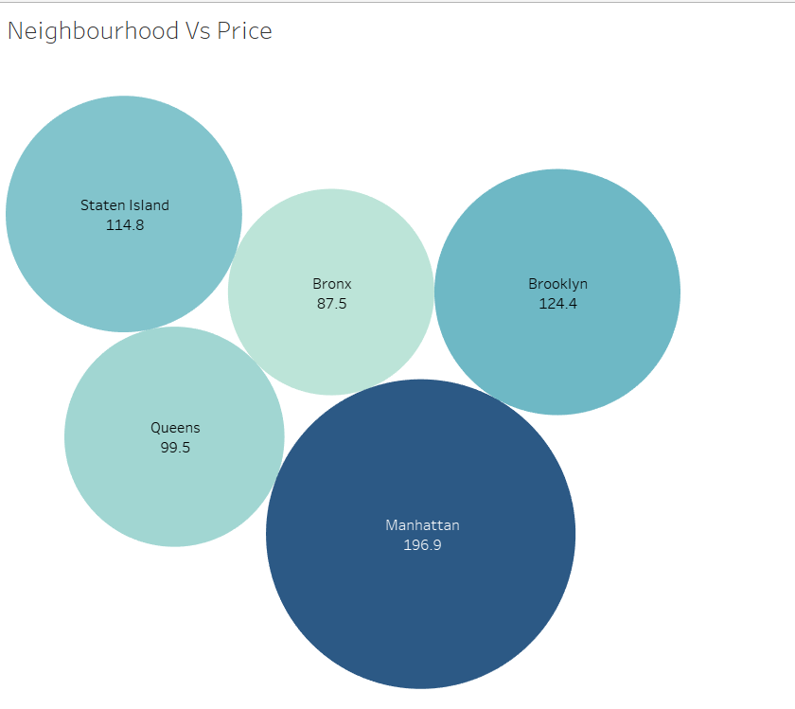
Neighbourhood average price:
The average price of listed properties in Manhattan is around 196.9, which is highest among all neighbourhoods.
Average price for Brooklyn is second highest i.e. 124.4
Bronx is lowest among all the neighbourhood

Slide 8
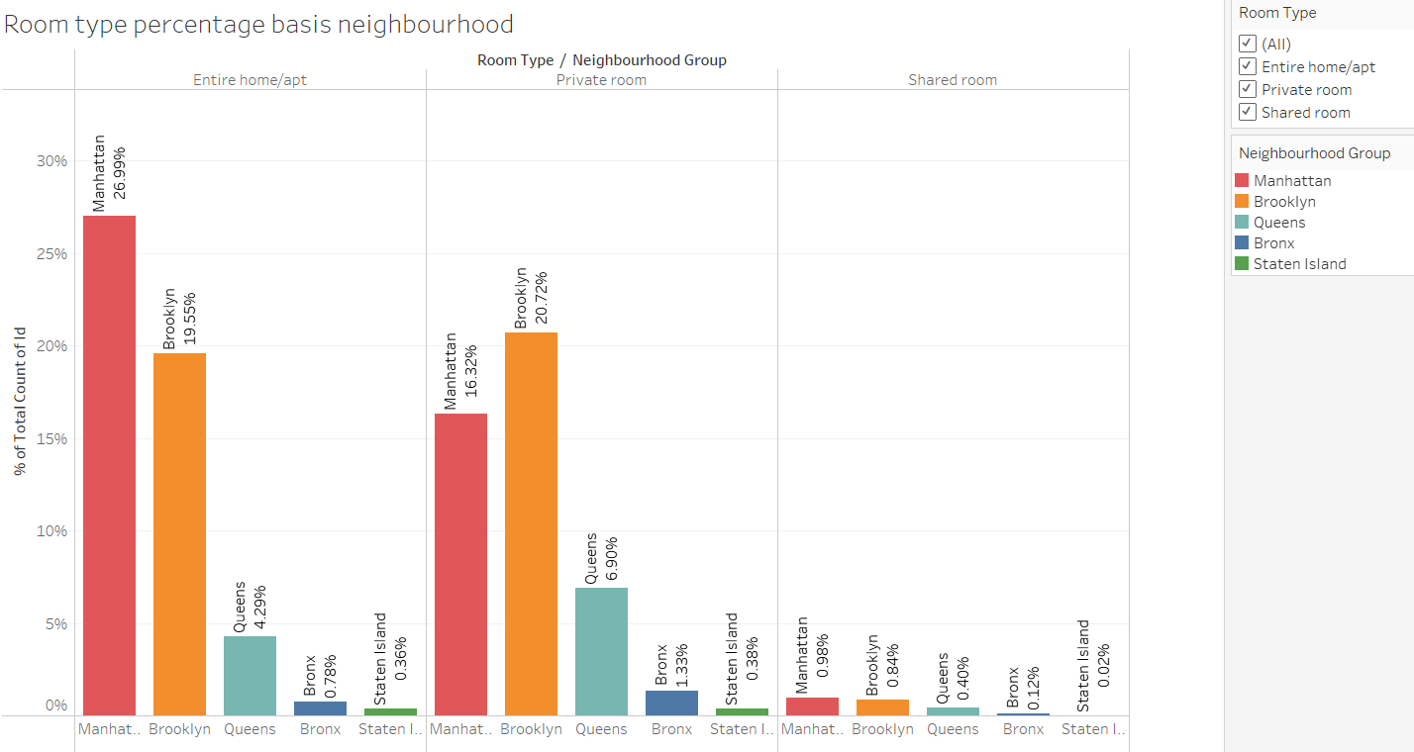
Room type percentage basis neighborhood :
The room type booking percentage for Manhattan for Entire home/apt is 26.99%, which is most as compared to other areas for this room type some campaign/offers need to initiated for Brooklyn, Queens, Bronx and Staten Island as to increase the booking so that the revenue can be generated.
The room type booking percentage for Brooklyn for Private room is 20.72%, which is most as compared to other areas for this room type some campaign/offers need to initiated for Manhattan, Queens, Bronx and Staten Island as to increase the booking so that the revenue can be generated.
The room type booking percentage for Shared room is low for all the areas campaign/offers need to be initiated as to increase the booking so that the revenue can be generated.

Slide 9
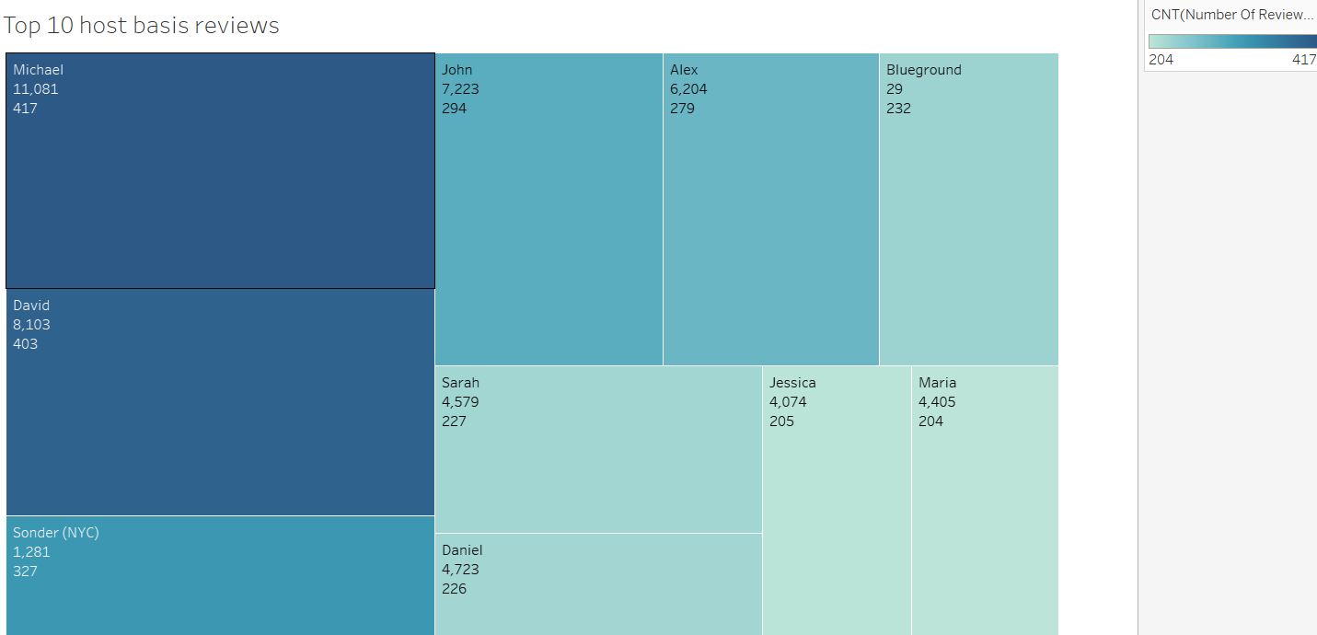
Top 10 hosts basis reviews:
Host name Michael has been booked for most number of times booked by customers that is 417 and the total reviews received is 11,081
David is the second popular host with 403 times booked by the customers and the total reviews received is 8,103
Maria and Jessica is booked least by the customers with 205 and 204 with rating received 4,405 and 4,074

Slide 10
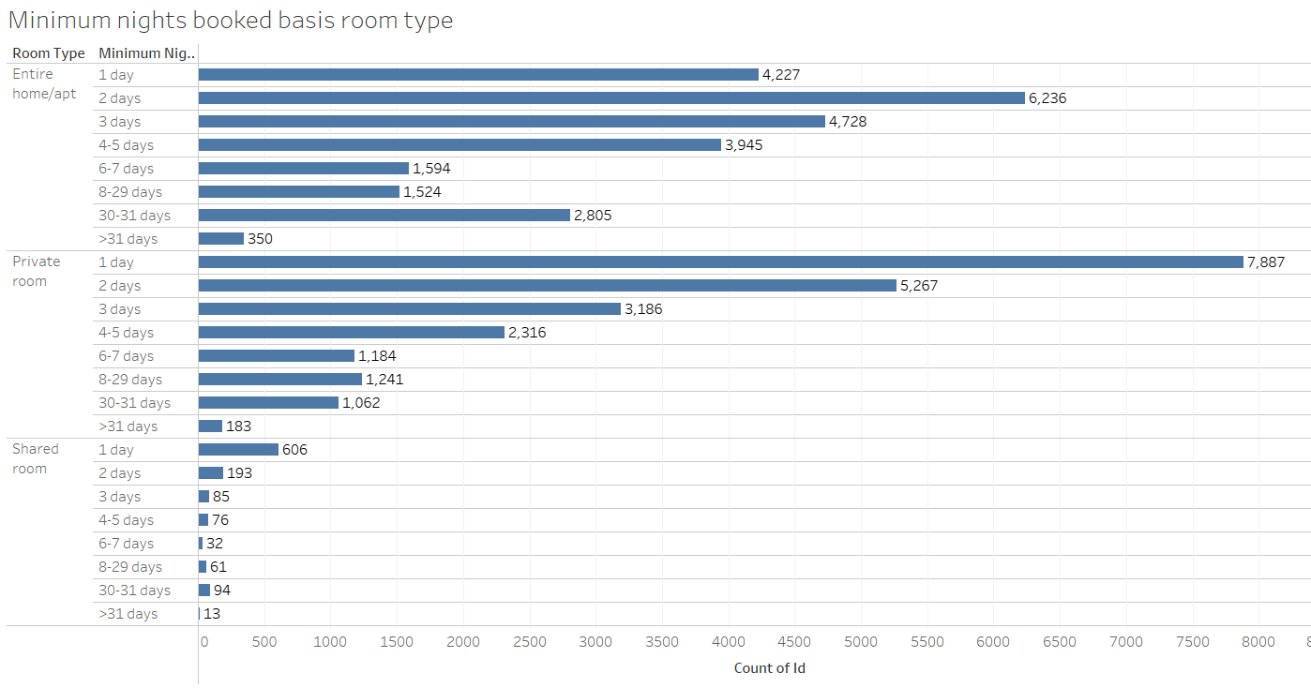
Minimum nights booked basis room type:
For all the Neighbourhood group the minimum nights with minimum nights listing from 1-5 days is most as compare to other listing and the least is >31 days with 350 bookings
Minimum night spend on Private room/Shared room for a days most
Bookings done for Entire room/apt for >30 is most this might be due to lease or rent and second is Private room and the lowest is Shared room.

Slide 11
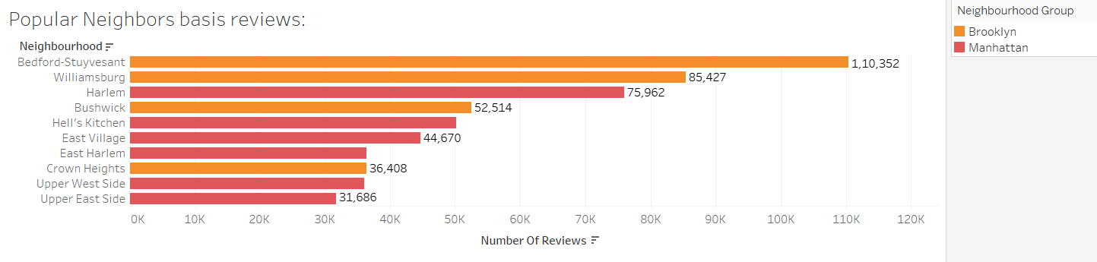
Popular Neighbourhoods :
We see that Bedford-Stuyvesant from Brooklyn is the highest popular with sum of reviews as 1,10,352
Harlem from Manhattan got the highest reviews as 75,962
The reviews indicates customers satisfactory and it also implies that they have an interest to review the properties most in Brooklyn and Manhattan.

Slide 12
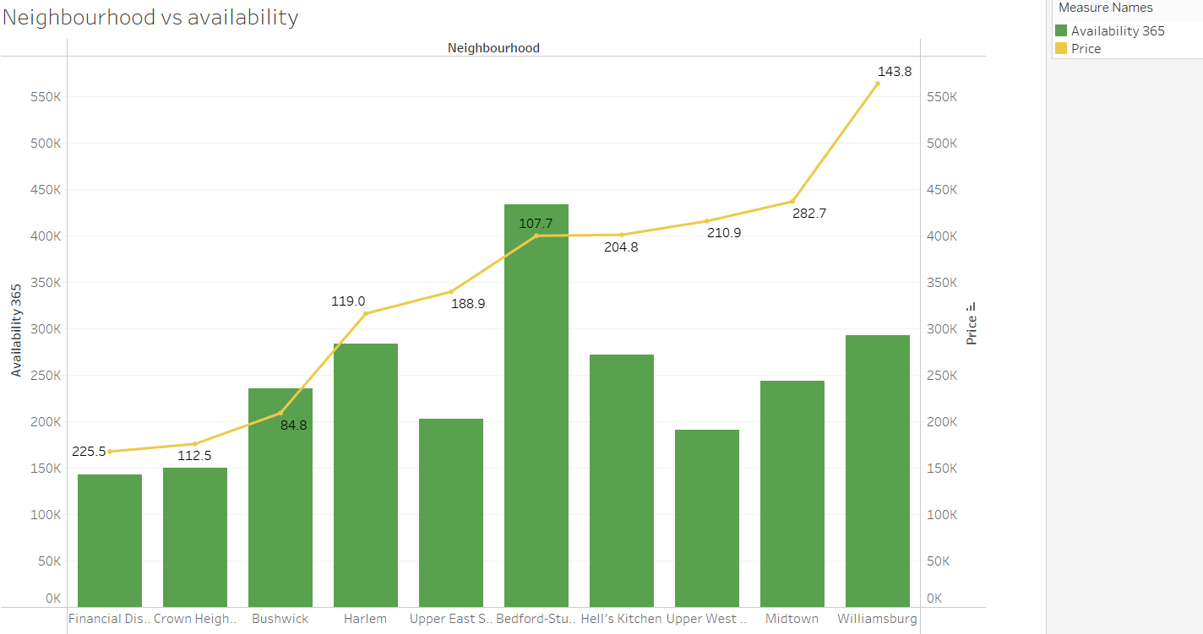
Neighbourhood vs Availability:
Availability of Bedford is highest and its price is on the lower side with average price 107.7 same trend follows by Bushwick with average price of 84.8. It is a good choice for customers.
Harlem, Williamsburg follow the same trend as high availability but the cost is much.

